Slide 1
Compliance Assessment Tool For DPDP Act

Slide 2

What Are Privacy Laws?
Regulations designed to protect personal data and ensure ethical usage.
Key Privacy Laws Around the world
Digital Personal Data Protection India
Personal Data Protection Law Saudi Arabia
Personal Data Protection Policy Oman
National Data Privacy Law Qatar
General Data Protection Regulation Europe

Slide 3
Common Themes
Compliance Themes Across Data Privacy & Protection Laws (e.g. EU GDPR, DPDP etc)
Consent
Notice
Impact Assessment
Processors
Accuracy
Record of Processing
Lawful Collection
Disclosure
International Transfers
Minimization
Storage Limitation
Data Protection Officer (DPO)
Security
Individual Rights

Slide 4
Data Lifecycle Support for Compliance
True champions of Data Management
Data Collection
Discover and Manage digital personal data estate with data minimization, process limits and storage rules
Data Label
Data gets Protected based on Policies, Data Principal Rights are managed, and data exposure is remediated for effective data protection. protection.
Data Activity Monitor
Data processing ensures minimization, tracks lawful activities, manages Data Principal Rights, and remediates data exposure.
Data Delete/Retired
Data gets Collected from various sources
Data Discovery
Data is Labelled based on Sensitivity and tracked for access rights and accuracy, and appropriately protected, including children’s data.
Data Protection
Monitor Data transfers, enforce location-based access, and respond to unauthorized data activities.
Personal Data Process
Manage data retention and lifecycle, mark documents as "Records," and conduct disposition reviews for safe deletion.

Slide 5
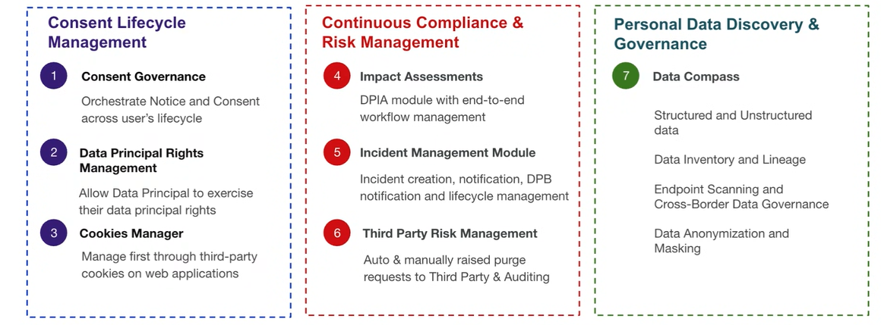
A Complete Solution for DPDP

Slide 6

Facts and Trends in Global Data Protection Laws
Organisations in India may face steep penalties under the DPDP Act, with fines up to ₹250 crore for failing to implement reasonable security safeguards; up to ₹200 crore for data-breach notification lapses or mishandling children’s data. (Source: DPDP Act Schedule as outlined by Apar Law, Tsaaro, and others)
Globally, the average cost of a data breach in 2024 reached USD 4.88 million, underscoring the financial importance of compliance. (Source: IBM Cost of a Data Breach Report, 2023)

Slide 7
The Need for Compliance Assessment Tool
Complexity
Privacy laws like GDPR, PDPL, and DPDP are complex and constantly evolving.
Risks
Non-compliance leads to hefty fines, reputational damage, and legal risks.
Challenges
Manual processes are slow, error-prone, and resource-heavy.
Benefits
AI Automated tools ensure accuracy, scalability, and efficiency.
Adaptability
A compliance tool helps organizations stay audit-ready and adaptable. give title for this

Slide 8
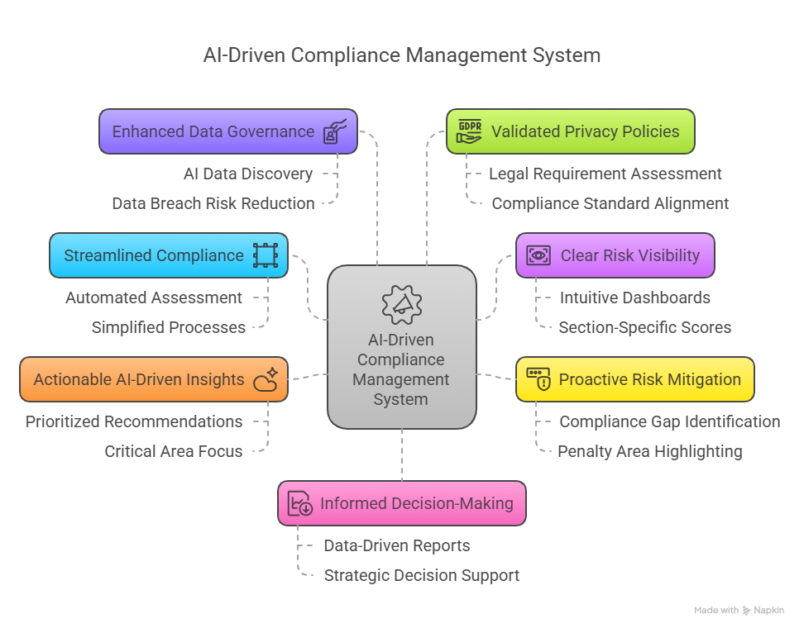
Value and Impact of the Tool

Slide 9

Demo

Slide 10
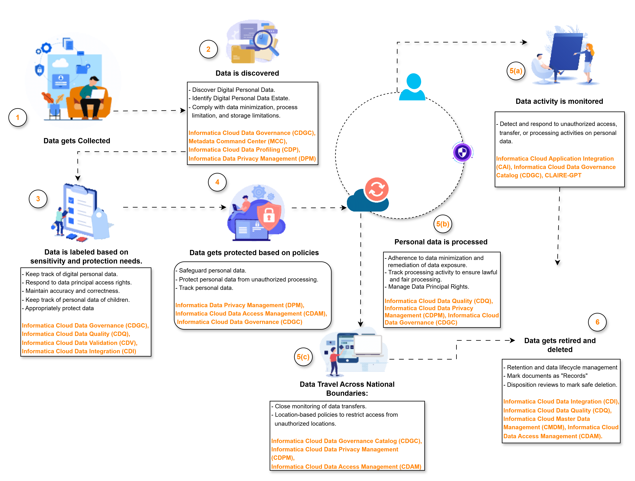
Reference Architecture

Slide 11
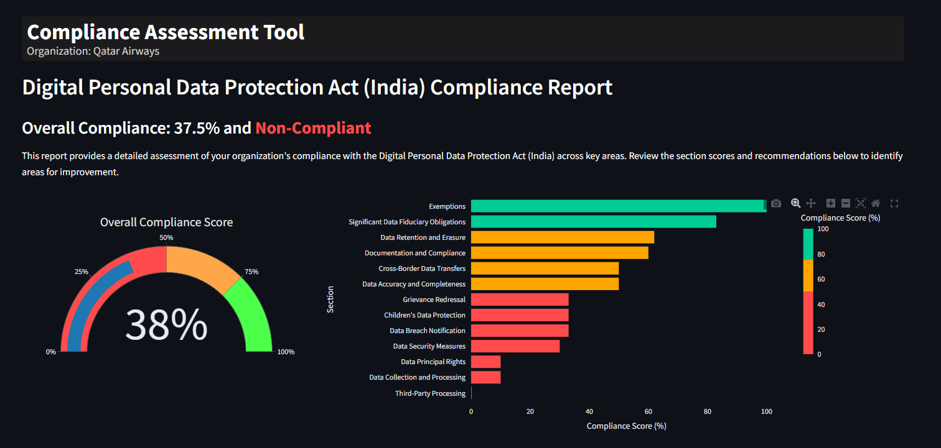
Features of the Compliance Assessment Tool

Slide 12
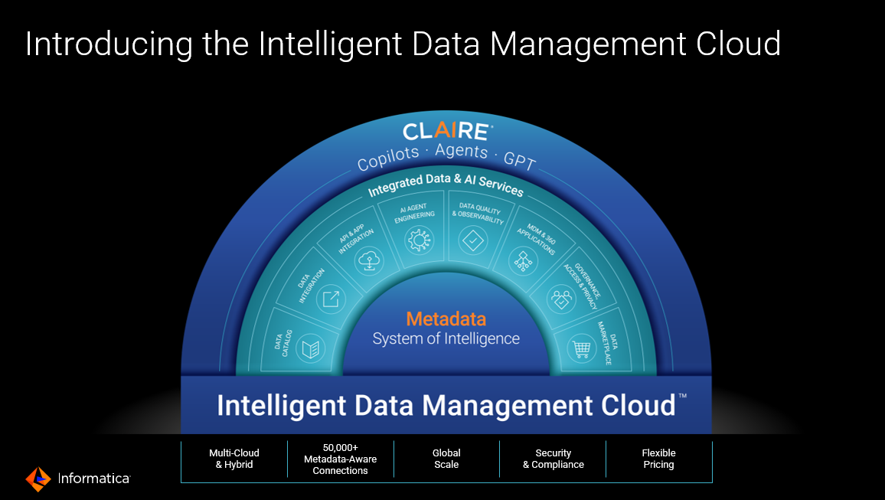

Slide 13















Clients Who Trust Us With Their Data
India
USA
UAE
India
Qatar
UAE
ME
UAE
ME & Africa
Qatar
India
India
USA
UAE
India & USA

Slide 14
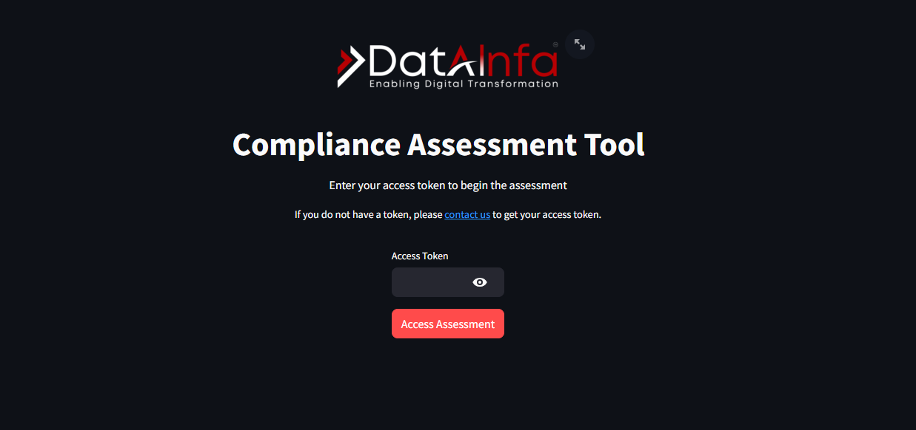
Sneak peek into our Compliance Assessment Tool

Slide 15
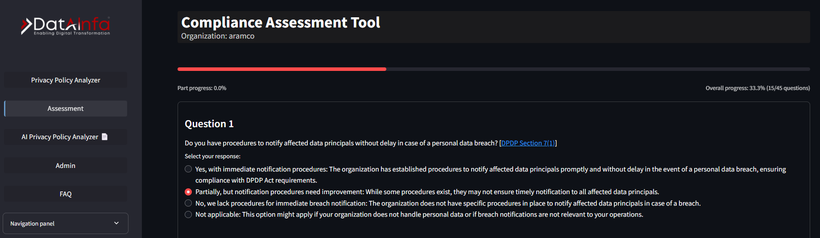
Sneak peek into our Compliance Assessment Tool

Slide 16
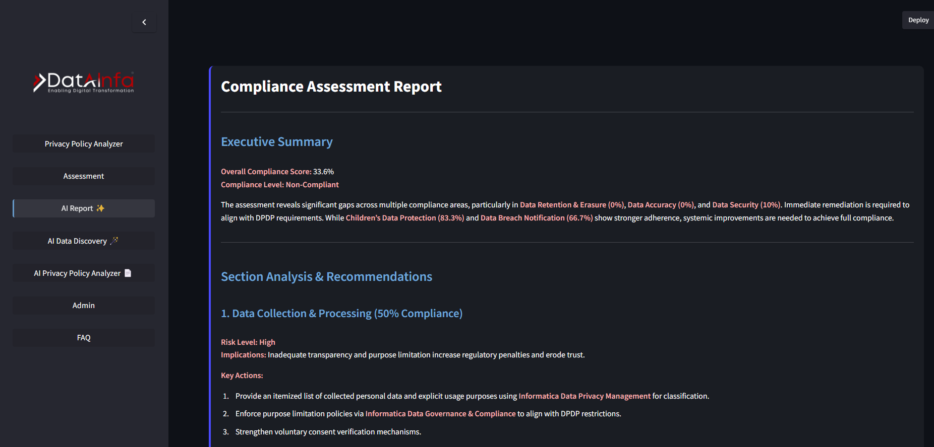
Sneak peek into our Compliance Assessment Tool

Slide 17






Thank You
LOCATIONS
India | Dubai | USA | Saudi Arabia | Singapore | Australia
EMAIL
info@datainfa.com
PHONE
+91 8320393920 | +91 8588845077 | +91 8861143928 | +971 585600941
www.datainfa.com

Slide 18
